Slide 1
COST OF LIVING IN THE UK: INSIGHTS VIA AI, DATA VISUALIZATION, AND STORYTELLING
Amin Sabbagh

Slide 2
Research Question
"To what extent has the Cost-of-Living Crisis affected the working adults in the UK, and how can a combination of machine learning-driven and traditional data visualization storytelling enhance our understanding of these impacts?"

Slide 3
Presentation Timeline
Introduction
1
Linear Regression models and Evaluation
2
Further insights using traditional data visualizations
3
A look at behind the scenes including tools and techniques
4
Closing remarks and recommendations
5

Slide 4
Introduction
General Insights into the Cost-Of-Living Crisis

Slide 5

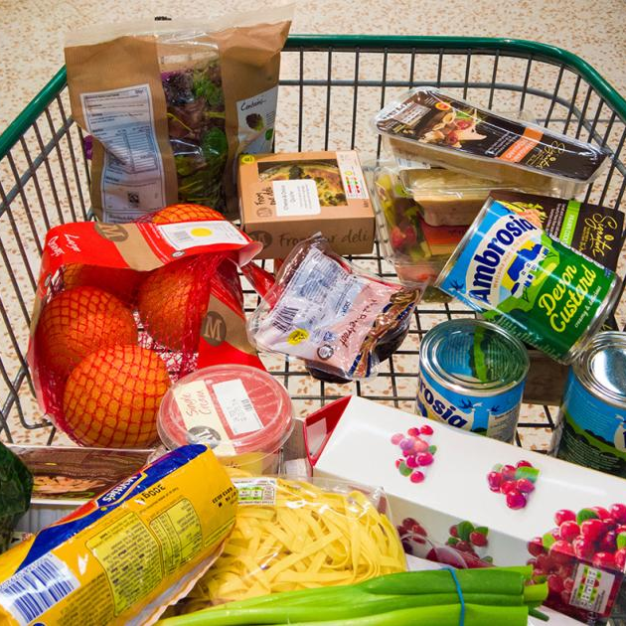
Introduction
The Cost-of-Living Crisis saw the most significant decline in living standards recorded in the past 60 years in the UK.
There is a fundamental gap where everyone knows that the crisis has impacted the population, but no one can visually explain the impact in a way that seems to encompass the severity of it.

Slide 6
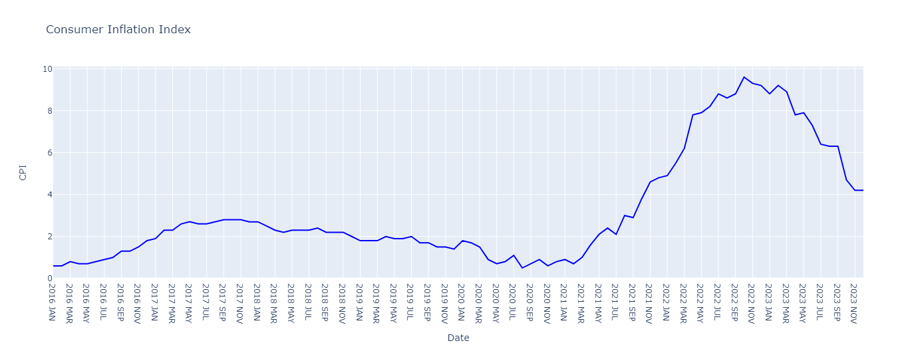
Timeline of CPI
Notes:
This line graph spans the period just before Brexit and the final months of 2023.
It reveals a sharp increase in the inflation rate since late 2021, peaking at 9.6% in October 2022.

Slide 7
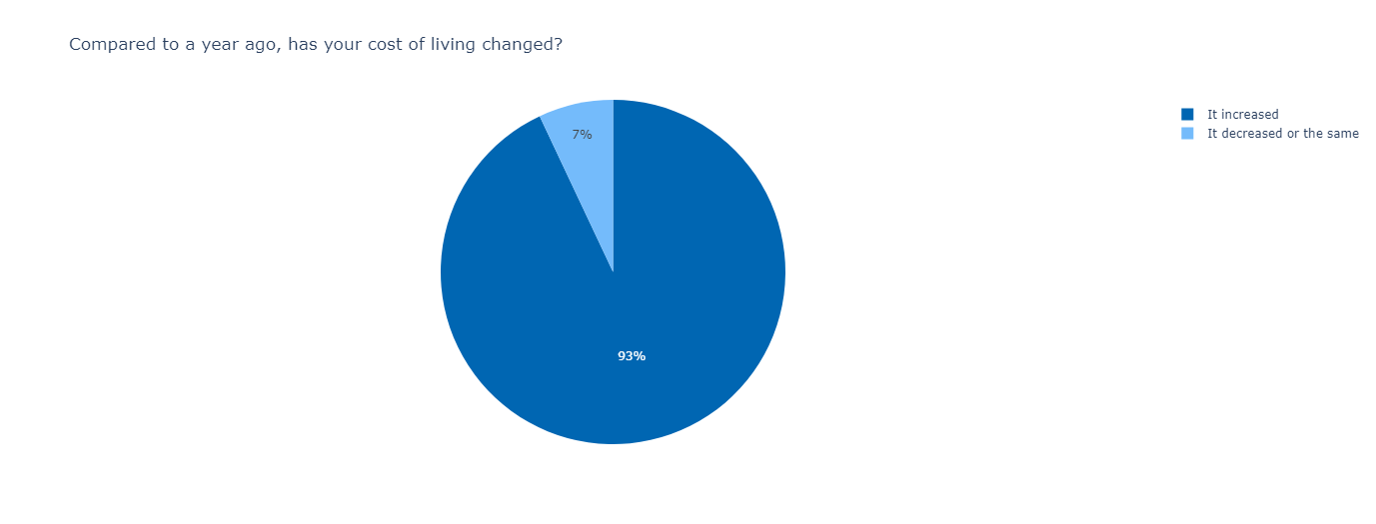
Compared to a year ago, has your cost of living changed?
Notes:
93% of adults have experienced an increase in their cost of living.

Slide 8
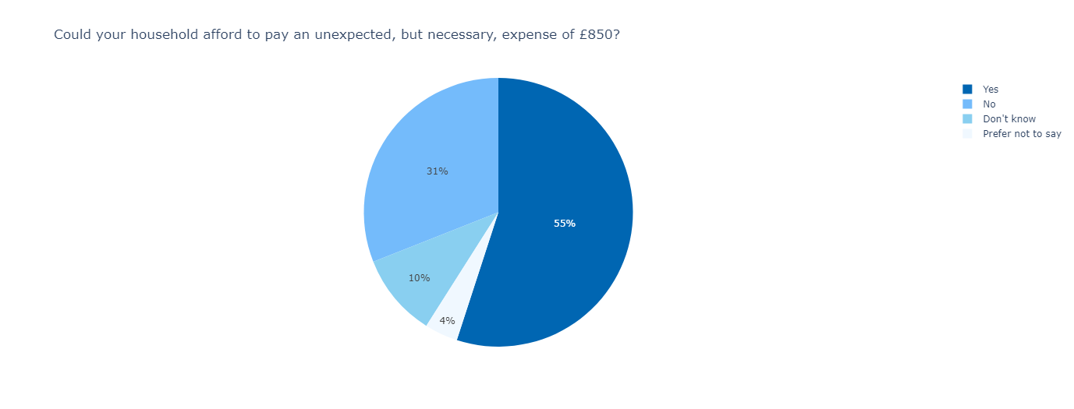
Could your household afford to pay an unexpected, but necessary, expense of £850?
Notes:
Nearly half potentially unable to meet an £850 expense, which could encompass critical necessities such as food, energy, or housing.

Slide 9

Do you think you will be able to save any money in the next 12 months?
Notes:
A significant 44% of respondents expressed a negative outlook, stating they would not be able to save any money.

Slide 10

Concerning Trends: The rate of negative responses is concerning on multiple fronts.
Notes:
It shows the challenges individuals face in affording essentials.

Slide 11
Linear Regression Models
How much does cost of living impact these sectors?

Slide 12

Where did I get the data from?
All datasets I used were from the UK’s Office of National Statistics
Secondary datasets
mitigates privacy concerns

Slide 13
Focusing on…
Food | Fuel | Housing
Food Inflation | Gas Prices | Rental Price
Restaurant Inflation | Motor Fuel Price | House Price
Notes:
The Focus is on these sectors

Slide 14

The Linear Regression model
Popular method for exploring the relationship between two continuous quantitative variables
The closer the data points align with the regression line, the stronger the correlation between the variables
Enables prediction of one variable based on the value of another
Notes:
Popular method for exploring the relationship between two continuous quantitative variables
A lot of similar studies use them

Slide 15
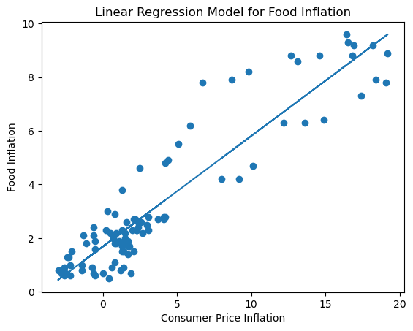
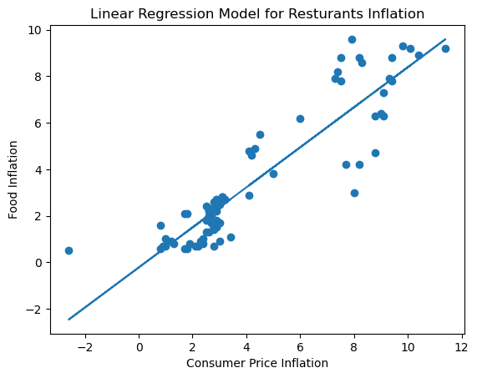
Overall Food Inflation
Notes:
The linear regression model for food reveals a strong relationship between CPI and food inflation, as illustrated by the close alignment of data points with the regression line.
The analysis also indicates a strong relationship between CPI and restaurant inflation, as evidenced by the close alignment of data points with the regression line.

Slide 16
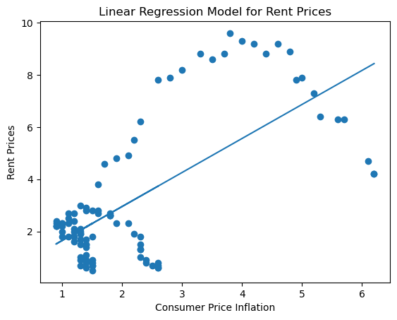
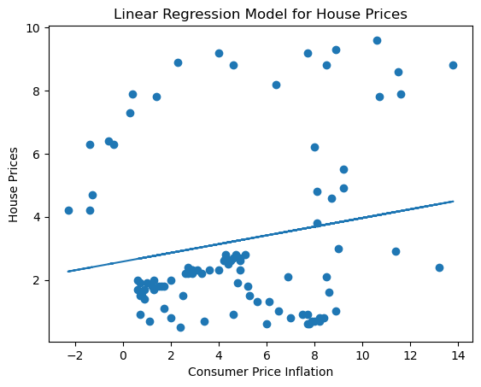
Overall Housing Prices
Notes:
The linear regression model for rent prices exhibits a curvilinear pattern rather than a linear relationship.
The linear regression model for house prices presents a scatterplot with no discernible relationship.

Slide 17
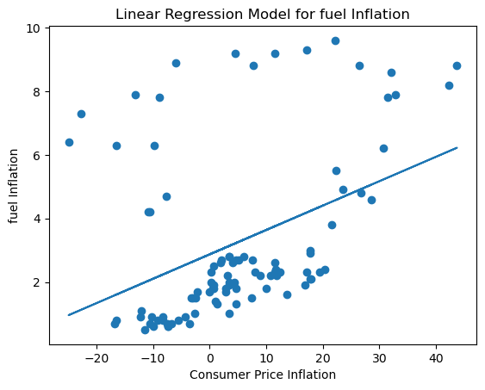
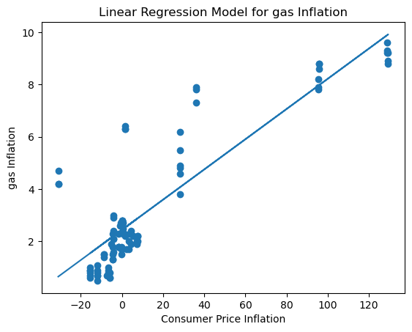
Overall Fuel Prices
Notes:
The linear regression model for motor fuel inflation indicates a weak relationship, as depicted by scattered data points with no discernible patterns.
The linear regression model for gas inflation reveals a notable relationship between CPI and gas inflation, as evidenced by the close alignment of data points with the regression line.

Slide 18
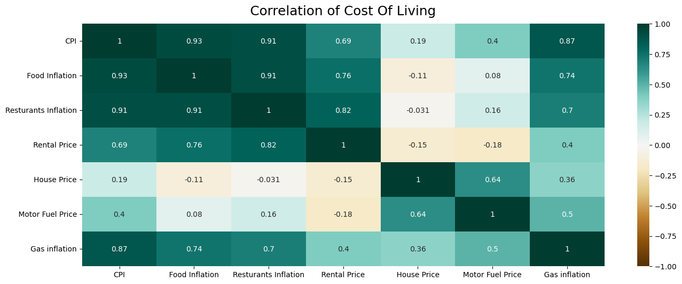
Evaluation: The Correlation Coefficient (R)
Notes:
Food inflation appears to be the most affected, followed by gas inflation, and then rental prices.

Slide 19
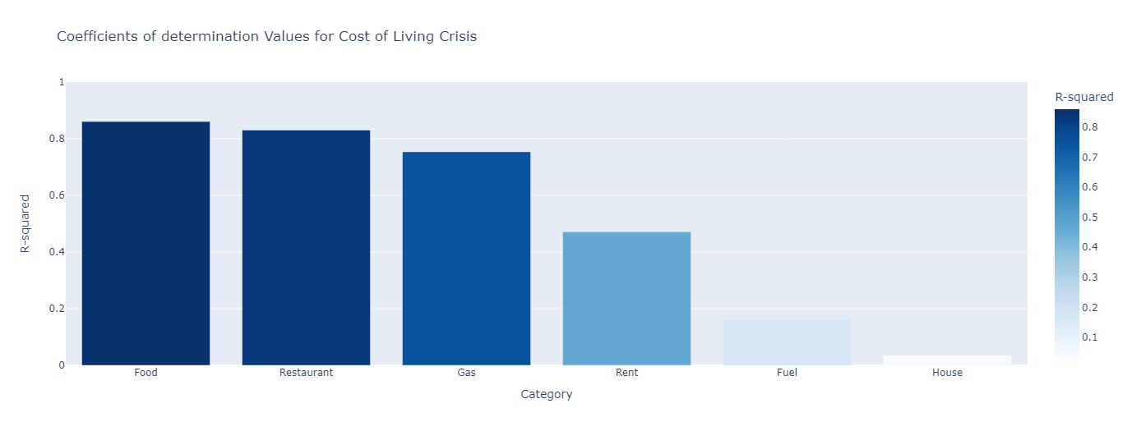
Evaluation: Coefficients of determination
Notes:
Coefficients of determination for Cost-of-Living Crisis" bar chart show that linear models are best fit for food and gas variables

Slide 20
Further insights
traditional data visualizations

Slide 21
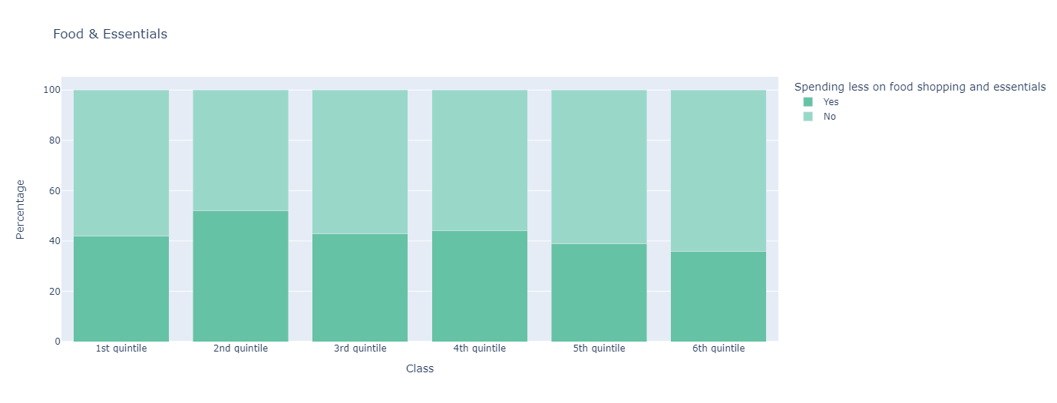
Food Spending
Notes:
Across all working classes, all reported spending less on food shopping and essentials.
Most nearing half on spending less, with exception of the 2nd class which 52% spends less.

Slide 22
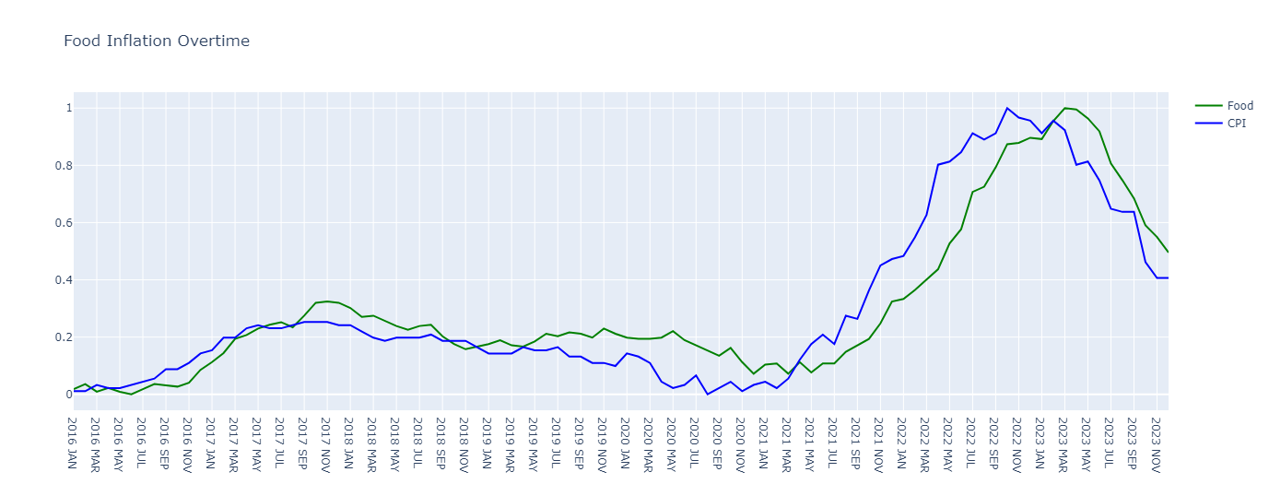
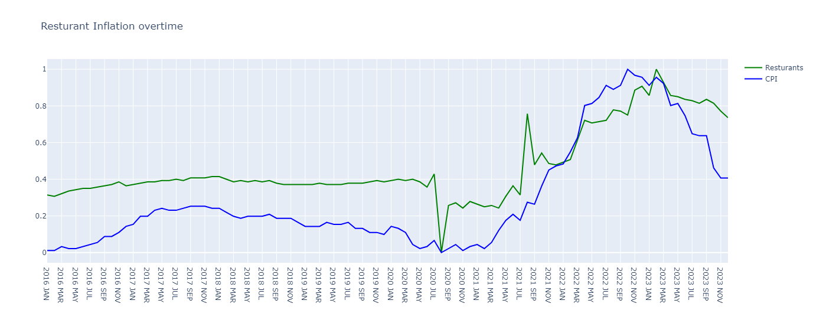
Food Spending Continued
Notes:
Food convergences at ten distinct points, while Restaurants lines intersect only five times.
This and the similar fluncations shows the strong relationship between overall food and CPI

Slide 23
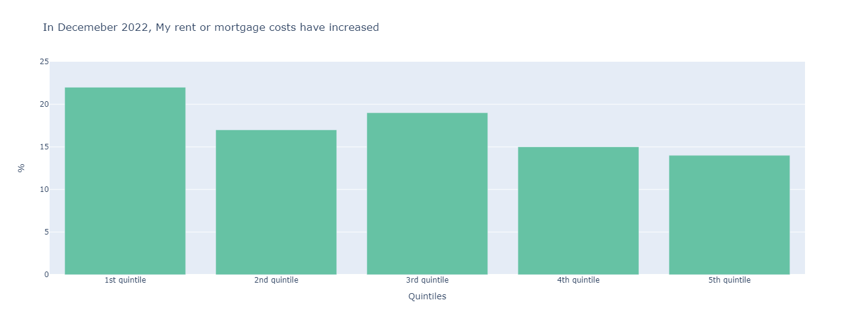
Housing costs
Notes:
The results did not indicate widespread difficulties, with less than 25% of each class reporting challenges.

Slide 24
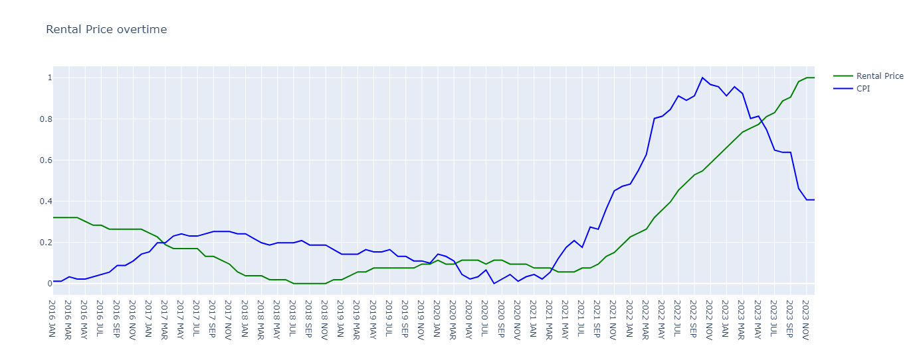
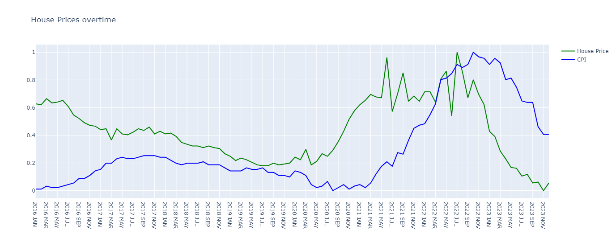
Housing costs continued
Notes:
Rent: Although there is convergence of these lines at five distinct points, indicating some degree of correlation, there doesn't appear to be a straightforward relationship.
Houses: There appears to be little to no relationship between them, despite converging at three points.

Slide 25
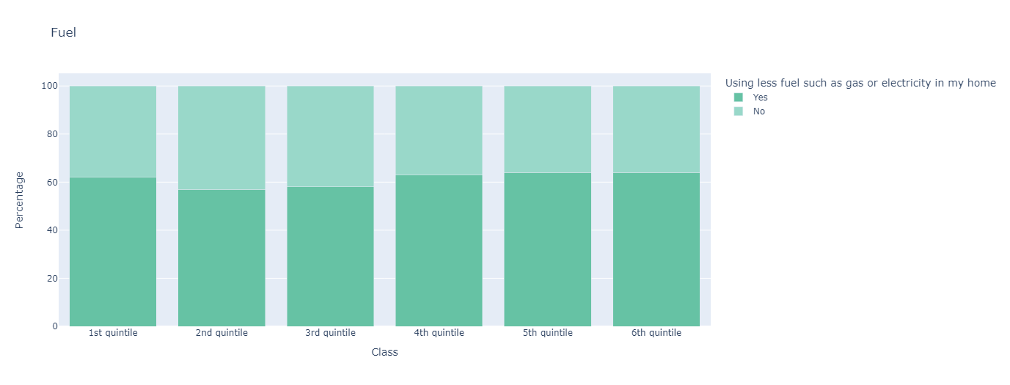
Home Fuel Spending
Notes:
Surprisingly, most respondents across all class quintiles reported spending less on fuel, despite the overall inflation in food prices being higher than gas price inflation.
This trend suggests that individuals may have opted to reduce their usage of heating rather than limiting their overall food consumption.

Slide 26
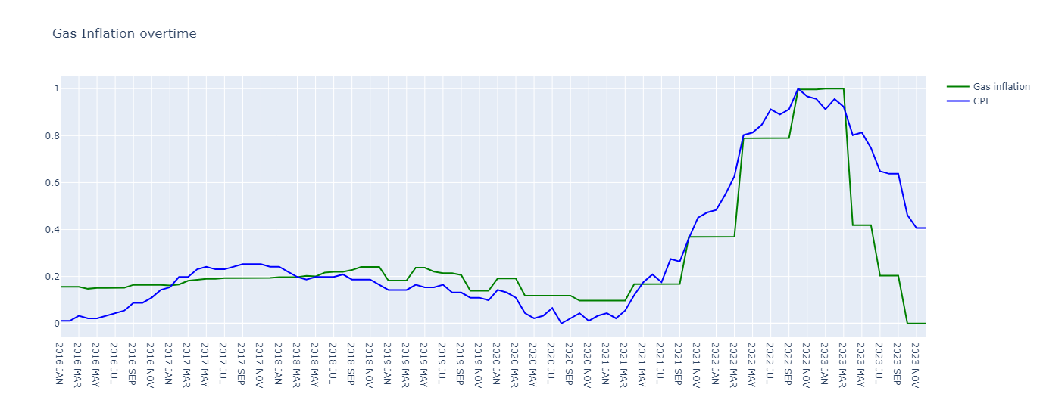
Home Fuel Spending continued
Notes:
The convergence of these lines at eight distinct points, and similar fluncations indicates a strong relationship

Slide 27
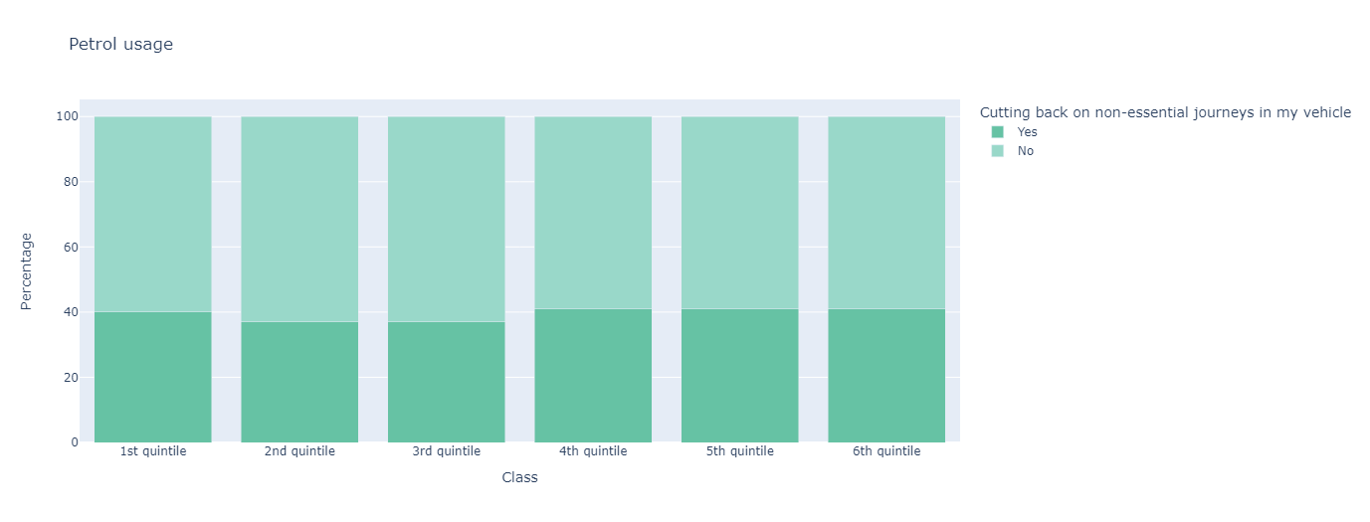
Motor Fuel Spending
Notes:
Surprisingly, nearly half of the respondents across each quintile reported limiting their spending in this area.
While this trend is not directly attributed to the inflation of CPI, it suggests that external factors such as the Ukraine war or taxation policies may be influencing consumer behavior.

Slide 28
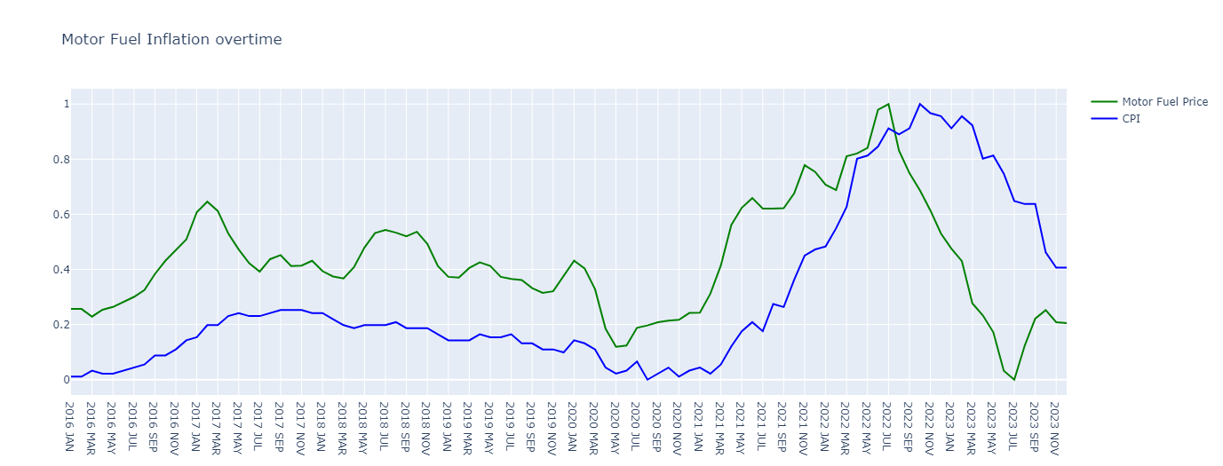
Motor Fuel Spending continued
Notes:
Only convergence at one-point, little connection between the two variables over time.

Slide 29
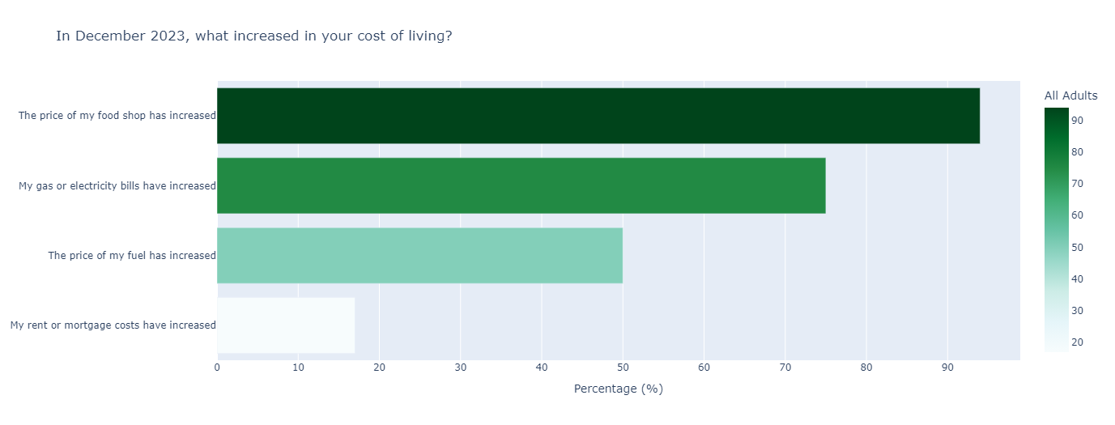
In Summary
Notes:
Primary Impact is Food Inflation
As individuals allocate more of their budget to food, they may face difficulties in meeting other basic needs

Slide 30
A look at behind the scenes
tools and techniques

Slide 31
Programming Language & Libraries
Python Programming Language
Pandas Python Library
NumPy Python Library
Matplotlib Python Library
Notes:
Python: Widely used in programming language for AI and Data science, a cost-effective choice
Pandas: Used to extract data from Excel into dataframes
NumPy: Used for numerical computing and array operations.
Matplotlib.pyplot: Used for creating machine-learning data visualizations

Slide 32
Programming Language & Libraries
Plotly Python Library
SciPy Python Library
Seaborn Python Library
Notes:
Plotly Express: Used to create interactive data visualizations.
SciPy.stats: Provides functions for statistical computations.
Seaborn: A data visualization library for drawing attractive statistical graphics.

Slide 33
A quick Look at Jupyter notebook pages
Data Visualisation
Data Preprocessing
More details and Insights
Interactive graphs
Graphs can be saved and presented elsewhere
Data extraction
Data Cleaning
Notes:
Go through the pages quickly, in order

Slide 34
Summary and Questions

Slide 35


Summary
Data visualization storytelling offers accessible insights into socio-economic events, aiding comprehension for a wider audience.
It effectively illustrates Cost-Of-Living Crisis's impacts on UK working adults, spotlighting heavily affected sectors.
Machine learning integration enhances analysis, uncovering deeper insights and predictive capabilities crucial for lawmakers.
These methodologies empower stakeholders with foresight to proactively address challenges.
Embracing innovative approaches fosters resilience in navigating crises and shaping a more equitable future.

Slide 36
Thank you
Amin Sabbagh
Notes:
Rising AWARENCE!!!!
Chose linear regression for the popularity and spesilisation.
All data found was continuous, so other logistic regression couldn’t work

